Slide 1
Android Development
Android Studio, Activities & Fragments

Slide 2
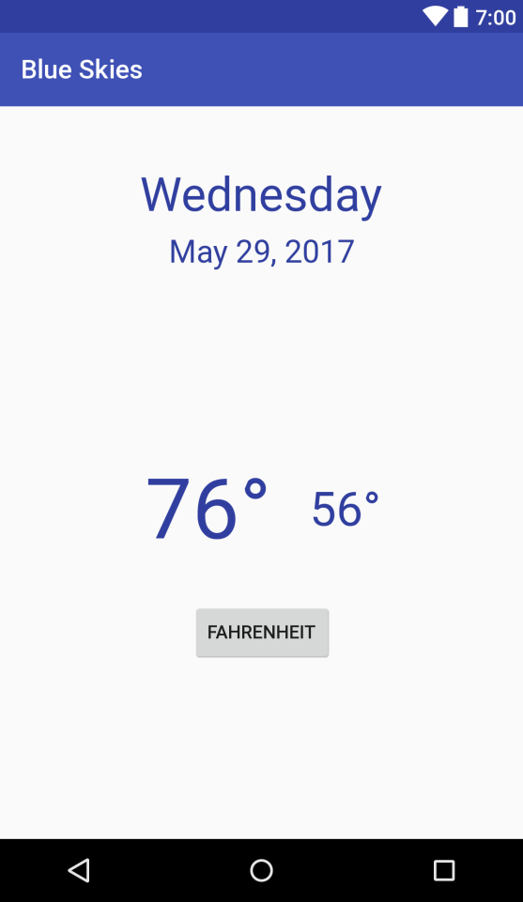
Goals
Develop a Blue Skies App
Activity
Fragment
Layout
Services
Http communication

Slide 3
What is Android
Google mobile SDK
Support Java and Kotlin
Open Source

Slide 4
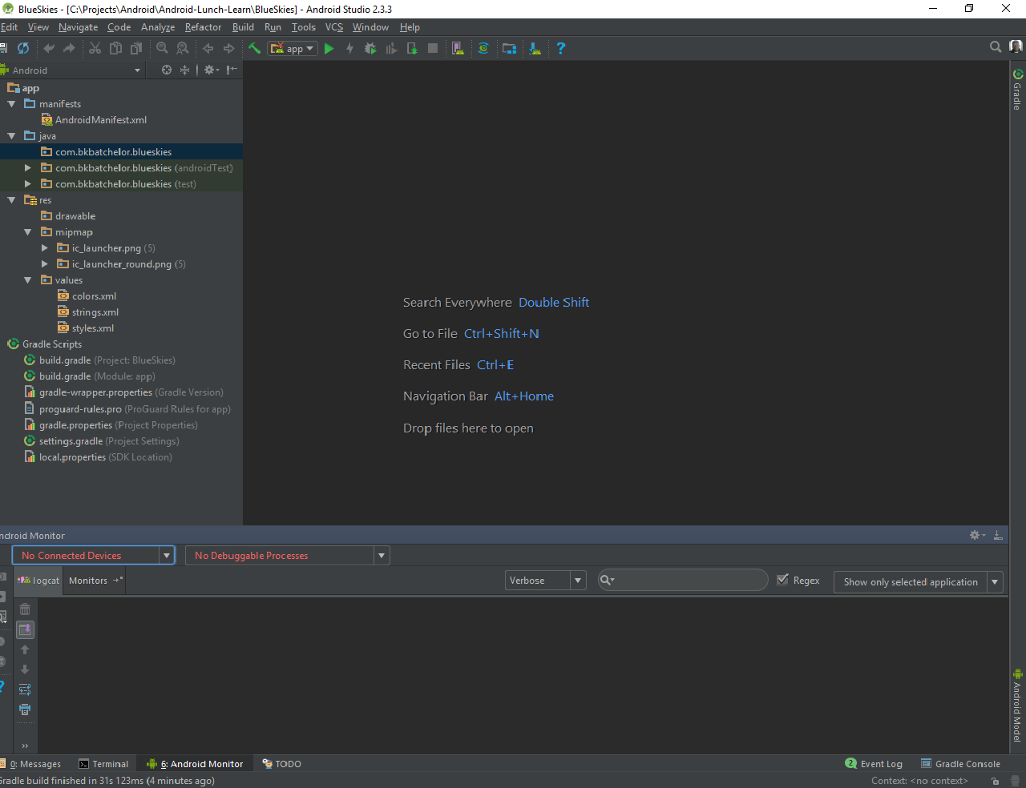
Android Studio
De facto standard for Android development
Built on the IntelliJ
Some features
Layout Editor
Built in emulator
Gradle integration
Instant Run (Hot swap)
https://developer.android.com/studio/index.html

Slide 5
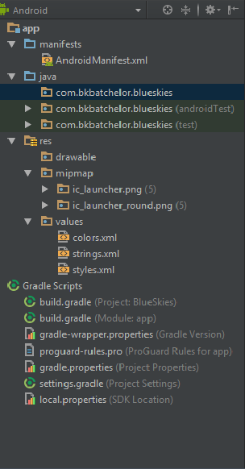

Project Pane

Slide 6
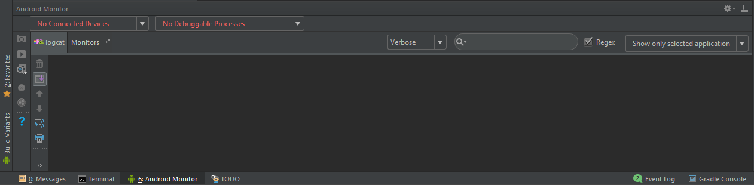
Logcat and Monitoring pane

Slide 7

Run and Debug

Slide 8
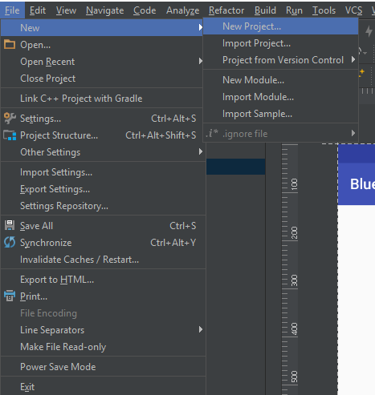
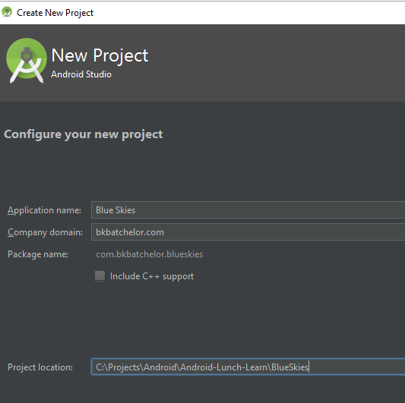
New Project

Slide 9
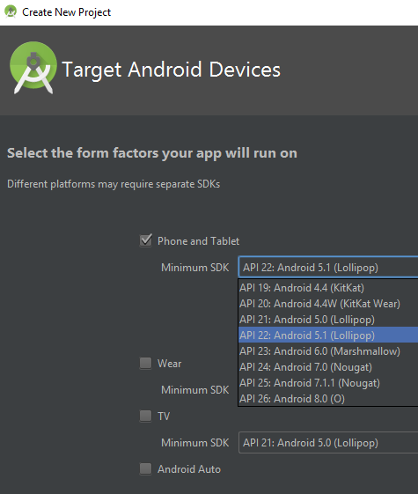
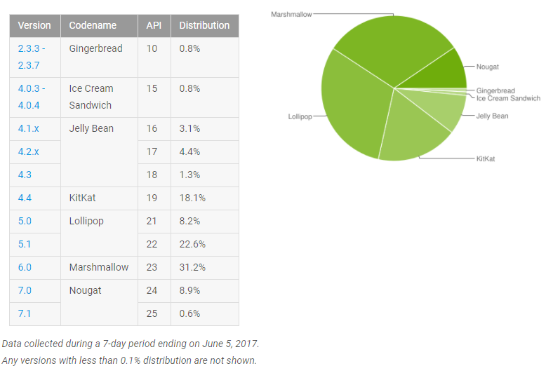
New Project (cont)

Slide 10
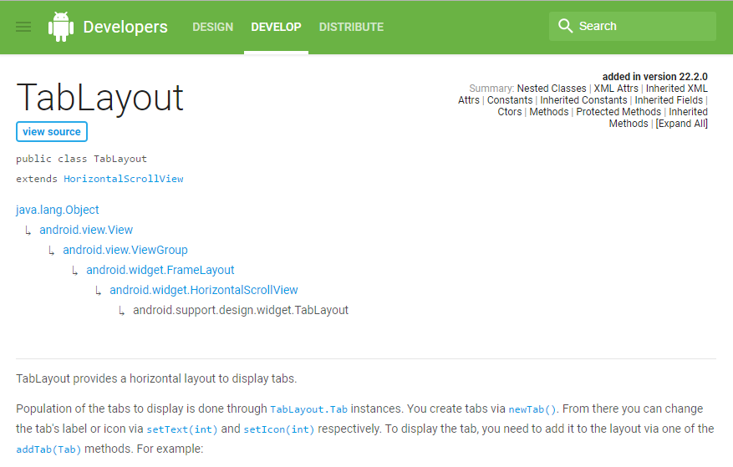
Android Reference
Min Support SDK Version

Slide 11
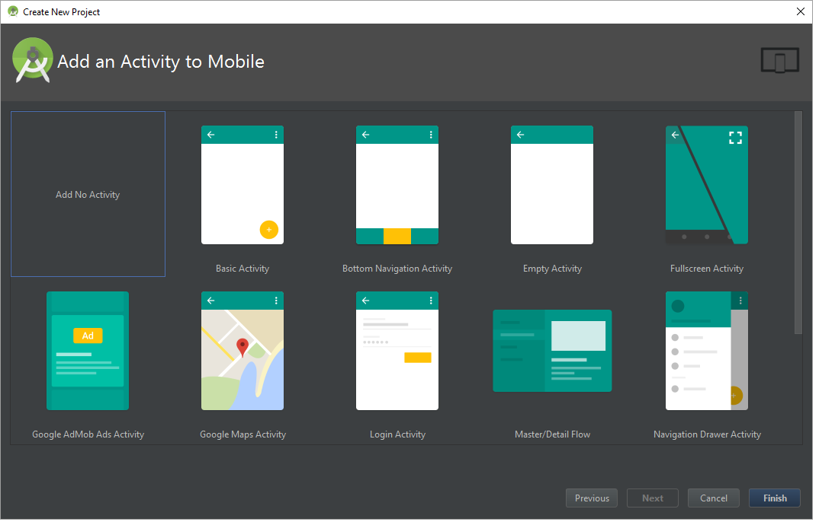
Add Activity

Slide 12
Exploring build.gradle file
Set target SDK version
Set minimum SDK version
Define dependencies

Slide 13
Activity

Slide 14

Activity https://developer.android.com/guide/components/activities/index.html
Fundamental building blocks
Entry point for user's interaction
Provides navigates within an app
Communication between other activities
Communication between child fragments
No Creation or Modification of Views

Slide 15
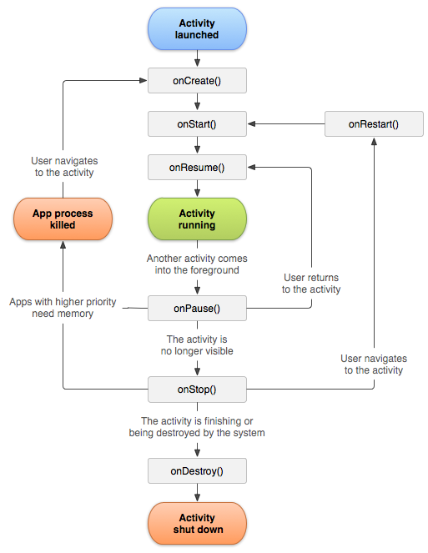
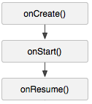
Activity Lifecycle
onCreate() started, but not visible
onStart() visible, but not ready for interaction
onResume() moved to the foreground and ready for interaction

Slide 16
Inside onCreate()
Process incoming data (i.e. Intent)
Initialize variables (non-view)
Assign Activity layout

Slide 17
Activity Lifecycle
onCreate() started, but not visible
onStart() visible, but not ready for interaction
onResume() moved to the foreground and ready for interaction

Slide 18
Inside onStart()
Initialize view objects (inside Fragment)
Register services

Slide 19
Activity Lifecycle
onCreate() started, but not visible
onStart() visible, but not ready for interaction
onResume() moved to the foreground and ready for interaction

Slide 20
Inside onResume()
Continue a service or action (ex. Stock market ticker)

Slide 21
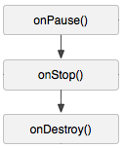
Activity Lifecycle
onPause() moving to the background and stopping user interaction
onStop() moved to the background and not visible
onDestroy() moved to the background and flagged to be destroyed by the system

Slide 22

Inside onPause()
Pause service(s) or actions
Save data to a persistent storage

Slide 23
Activity Lifecycle
onPause() moving to the background and stopping user interaction
onStop() moved to the background and not visible
onDestroy() moved to the background and flagged to be destroyed by the system

Slide 24
Inside onStop()
Unregister Service(s)

Slide 25
Activity Lifecycle
onPause() moving to the background and stopping user interaction
onStop() moved to the background and not visible
onDestroy() moved to the background and flagged to be destroyed by the system

Slide 26
Inside onDestroy()
Clean up anything else

Slide 27
Cycle Relationships
onCreate()
onDestroy()
onStart()
onStop()
onResume()
onPause()

Slide 28
Creating MainActivity
Best Practices
Keep lifecycle methods in order
Place other methods (helpers) below the lifecycle methods

Slide 29
XML Layout
Add XML Layout
XML Layout holds ViewGroups (layouts) and View (widgets)
Best practices
Layout naming convention
MainActivity.java => main_activity.xml

Slide 30
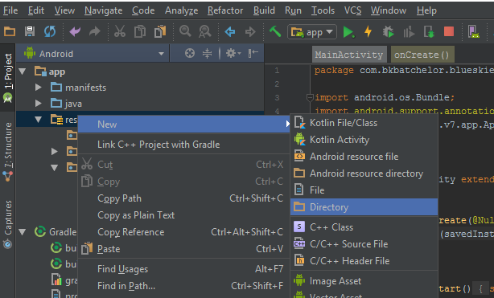
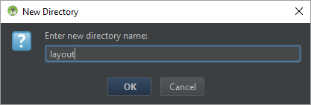
Creating Layout directory

Slide 31
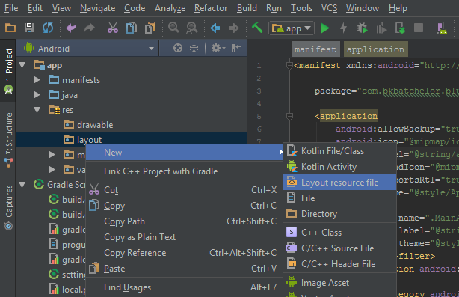
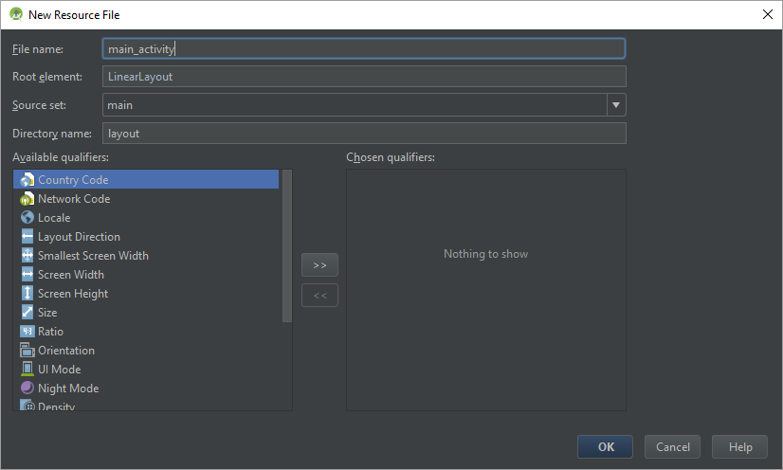
Creating layout XML

Slide 32
Show main_layout.xml

Slide 33
Layouts
Types of layouts
Linear
Relative
Frame
Constraint
Best Practices
Attempt to keep the layout flat by avoiding nest layouts

Slide 34
Example: Link Activity to Layout

Slide 35
Editing Android Manifest
Add MainActivity to AndroidManifest.xml
The manifest file provides essential information about your app to the Android system, which the system must have before it can run any of the app's code. (i.e. activities, services, content provider…)

Slide 36
Live Example: Adding MainActivity to manifest file

Slide 37
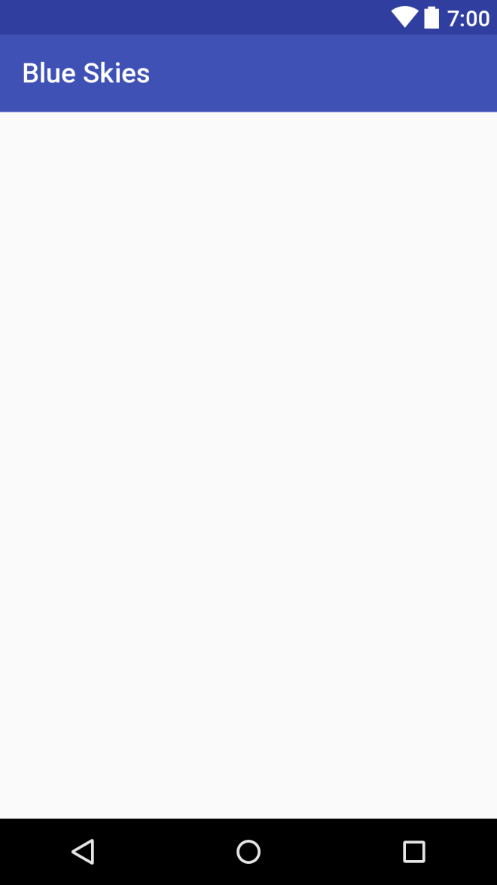

Slide 38

Fragments

Slide 39
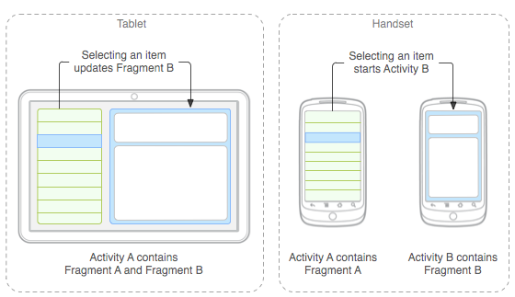

Why Fragments?
Reusing View and Logic
Single responsibility
Phone and tablet layouts
Screen orientation

Slide 40
Fragment Responsibilities
View and Layout logic
Event handling (i.e. onClick())
Network request
Interacting with a persistence storage

Slide 41
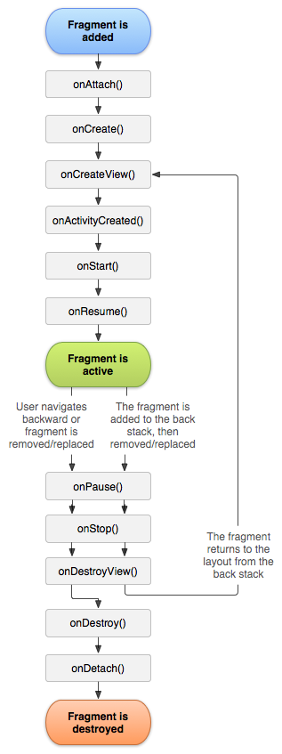
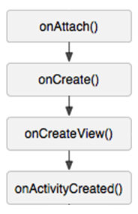
Fragment Lifecycle
onAttach() connected to an activity, but not started
onCreate() started, but view object has not been created
onCreateView() started, view object being created, but not visible
onActivityCreated() started, view object instantiated by parent Activity, but not visible

Slide 42
Inside onAttach()
Save parent activity context for:
Callbacks to parent activity
Content provider (database)
others

Slide 43
Fragment Lifecycle
onAttach() connected to an activity, but not started
onCreate() started, but view object has not been created
onCreateView() started, view object being created, but not visible
onActivityCreated() started, view object instantiated by parent Activity, but not visible

Slide 44
Inside onCreate()
Initialize non-view attributes

Slide 45
Fragment Lifecycle
onAttach() connected to an activity, but not started
onCreate() started, but view object has not been created
onCreateView() started, view object being created, but not visible
onActivityCreated() started, view object instantiated by parent Activity, but not visible

Slide 46
Inside onCreateView()
Inflate fragment view with layout
Initialize view attributes

Slide 47
Fragment Lifecycle
onAttach() connected to an activity, but not started
onCreate() started, but view object has not been created
onCreateView() started, view object being created, but not visible
onActivityCreated() started, view object instantiated by parent Activity, but not visible

Slide 48
Inside onActivityCreated()
Perform callbacks by used context

Slide 49
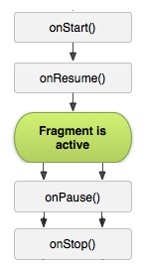
Fragment Lifecycle
onStart() visible, but not ready for interaction
onResume() moved to the foreground and ready for interaction
onPause() moving to the background and stopping user interaction
onStop() moved to the background and not visible

Slide 50
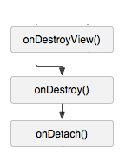
Fragment Lifecycle
onDestroyView() not visible and view detached from fragment
onDestroy() flagged for deletion
onDetach() detached from parent Activity

Slide 51
setRetainInstance
void setRetainInstance (boolean retain) -
Control whether a fragment instance is retained across Activity re-creation (such as from a configuration change)

Slide 52
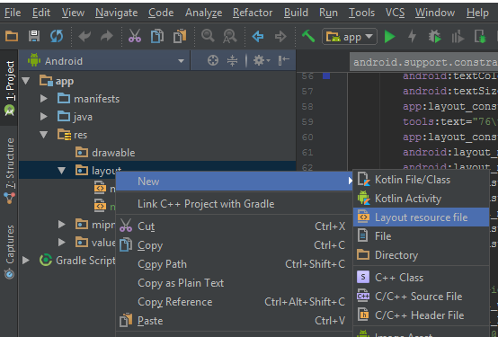

Creating Fragment XML Layout

Slide 53
Show Fragment Layout Code

Slide 54
Text Strings
Best practice
Reference string from strings.xml

Slide 55


Density Independent Pixel (dp)
View Groups and View dimensions
Scale according to screen density, not screen resolution
Hi resolution screen
Low resolution screen

Slide 56
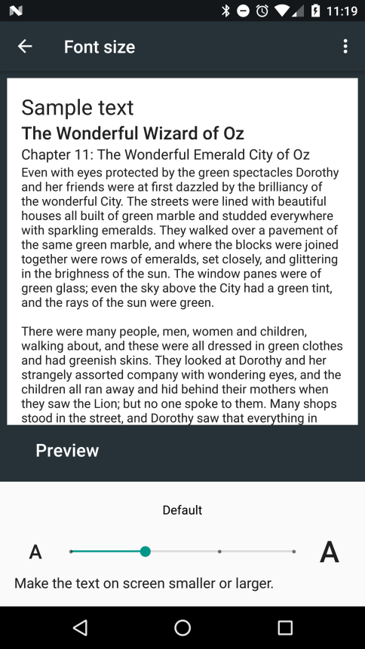
Scale Independent Pixel (sp)
Controlling text size
Scale according to screen density, not screen size
Also, scales according settings font settings

Slide 57
Fragment Code
Logic to fragment XML layout
onClick()

Slide 58
Show Fragment Code

Slide 59
Live Example Fragment Code

Slide 60
Final Step
Reference Fragment in Activity

Slide 61
Extra

Slide 62
Landscape Layout

Slide 63
Fragment callbacks

Slide 64
Dynamic Fragments

Slide 65
Passing arguments to Fragments

